Slide 1
Air Pollution in Nowon-gu
Minje Cho, 2021204069

Slide 2
Air pollution in Korea
Korea air pollution biggest issue -> fine dust
Then, what is the main issue of fine dust?

Slide 3
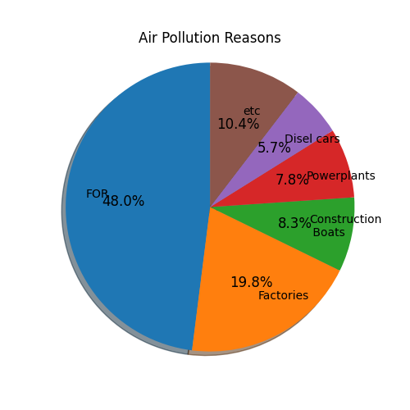
Check Fine Dust Reasons - Korea
Also, factories and constructions make lots of fine dust.
-> Preparation measures for environmental pollution in factories are needed.

Slide 4
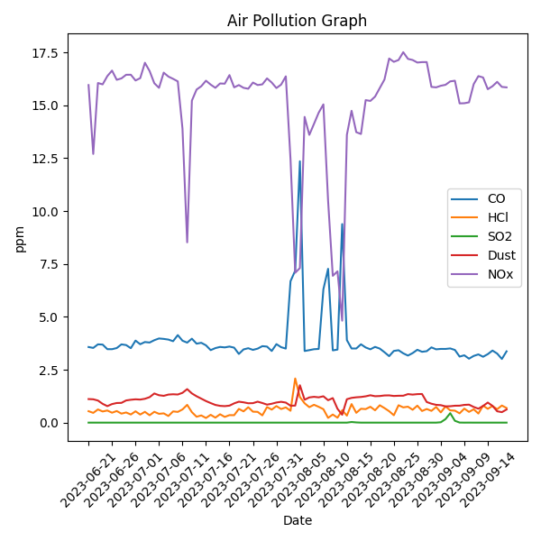
Check Air Pollution elements rate – Nowon-gu
NOx is the Biggest Problem.
Most of are from factories.
(especially cement factories
In Nowon-gu, cement factory removed in 12.2022)
But, in KOR legal standard, none of these do not exceed.
-> Nowon-gu does not have severe air pollution.
Why NOx is high? : Many factories are in Nowon-gu
(total 123(19.09.2023))

Slide 5
Solutions - Technology
- Air pollution emissions
Technology | explanation | For
Measurement/Sensor | Measure emissions and analyze the data | Nation, Companies
Removal/Management | To reduce, prevent pollutants to improve air quality | Industrial Companies
Pollution reduction materials | Develop materials considering types and characteristics of contaminants | Factories
Reduce automobile exhaust gas | Purify automobile engine exhaust gases | Car Factories (New cars)

Slide 6
Reference list
Factory list : https://www.industryland.or.kr
Technology for air pollution : Min Young Song(2019), Technical Management Plan for Improving the Atmospheric Environment in Seoul, p.127
Fine Dust Reasons : BBC(3.27, 2019), 미세먼지: 당신이 알아야 할 6가지 사실(Fine dust : 6 facts you need to know) https://www.bbc.com/korean/news-43524873
Air pollution elements rate : https://rrf.seoul.go.kr

